Slide 1
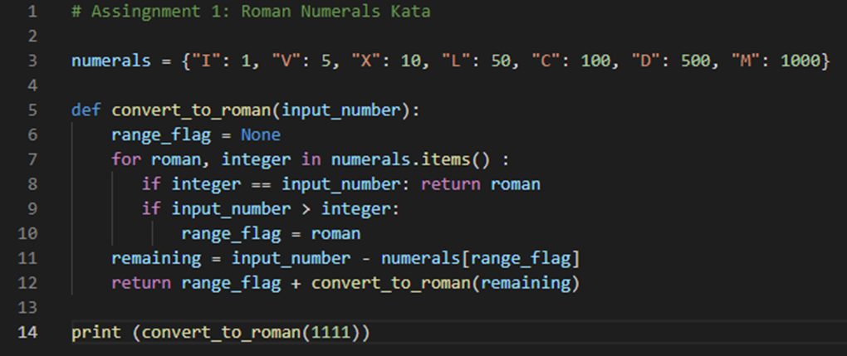

Assignment 1: Roman Numerals Kata

